Slide 1
Coming!
HEAVEN AND EARTH
The Battle
Identify the Breaches
& Fortify the Body
A StandingTrue Biblical Intensive
StandingTrue.com

Slide 2
Your Text
A SERIES FOR SERIOUS EVANGELICAL BELIEVERS
IDENTIFY & FORTIFY
The New Reality Is Here
The mystery of iniquity has made quantum leaps.
Do you understand Satan’s devices?
Are you prepared to defend the minds and hearts of:
Your Family? Your Friends? Your Church?
ARE YOU FORTIFIED?

Slide 3
What’s At Stake?
Can I Discern the Times?
Can I Stem the Flood?
IDENTIFY & FORTIFY
StandingTrue.com

Slide 4
Evangelical Breach #1: God’s Authority
^{The War Against Christ}
(Reshaping our view of creation.)
^{(Cosmology and Christology)}
The Attacks
GOD’S TRUTH TARGETED
The Battle for Heaven and Earth

Slide 5
Evangelical Breach #1: God’s Authority
The War Against Christ - Cosmology
Psalm 148
Colossians 1:14-20; Eph. 1:10
[When discussing Dominionism: Compare Isa. 65:17-25, Rev. 20:9 ff and all of 21.]
Biblical Battleground
CORE PASSAGES
The Battle for Heaven and Earth

Slide 6
Evangelical Breach #1: God’s Authority
The War Against Christ - Cosmology
Secular - FALSE CREATION: Christ’s law replaced with an imagined universal constant (science). Note: Evangelicals who miss this point fall into uniformitarian assumptions.
Secular - FALSE PERPETUATION: Christ’s power replaced with an imagined life force (evolution, vitalism, religion). Note: Evangelicals who miss this point fall into theistic evolution.
Evangelical - FALSE ADMINISTRATION: Heaven & earth melded. (Authority/free agency relegated to spirits/men. Note: Evangelicals who miss this point fall into open theism.
Case Study: The Bible Project as time allows.
The Arenas
TRUTH BLURRED

Slide 7
Evangelical Breach #1: God’s Authority
The War Against Christ - Cosmology
^{“Your eyes shall be opened”}
Veneration of “higher knowledge” from extra-biblical sources.
^{Where the leaven was embedded.}
Aquinas’ theology (Thomism) bridged the gap between heaven and earth by imbuing immutability into the creation. This allowed for a universal constant thus:
Thus equating science (so called) with revelation.*
Opening the door to both creation based worship & theistic evolution.
* When we rely on multiple sources of revelation we are heteronomous. Those who rely on scriptures alone as their final authority are autonomous.
Ancient Arguments
LEAVEN INFUSED

Slide 8
Evangelical Breach #1: God’s Authority
The War Against Christ - Cosmology
^{Reasoning from Christ}
• Christ carries all aspects of the creation forward through ordinances and direct fiat.
• There are NO inherent or inviolable laws of nature, only the decrees & ordinances of God.
• There is One Heaven & Earth Mediator.
First Principle
REASONING

Slide 9
Evangelical Breach #2: God’s Nature
^{The War Against God}
(Reshaping our view of the triunity.)
^{(Theology Proper)}
The Attacks
GOD’S TRUTH TARGETED
The Re-Envisioned Godhead

Slide 10
Evangelical Breach #2: God’s Nature
The War Against God – Theology Proper
Isaiah 55:9-11 -The Elohim verses in Isaiah 40-50 preclude any “god-ish” elohim class of beings.
Biblical Battleground
CORE PASSAGES

Slide 11
Evangelical Breach #2: God’s Nature
The War Against God – Theology Proper
“Elohim in God’s image” - demigods elevated & faux divine council.
“Trinitarian Panentheism” - The doctrine of “God, yet distinct from God” derives from panentheistic dynamics. (Don’t worry, we’ll make these terms understandable.)
Revival of “attributional” personages derives from ancient pagan (Babylonian) roots and anti-trinitarian texts.
Satan wants to close the gap between God and His creatures. (Isa. 40:13). He deifies God’s creatures and makes God more like His creatures.
^{Case Study: Bible Project}
The Arenas
TRUTH BLURRED

Slide 12
Evangelical Breach #2: God’s Nature
The War Against God – Theology Proper
“Ye shall be as gods”
Veneration of ancient Jewish and Gentile wisdom.
Ancient paganism and post captivity Jewish wisdom were embedded into early church thought by men like Origin. Thanks to highly touted modern study tools, new articulations of ancient views on the godhood and elohim are now being re-inserted by men like N.T. Wright, the Bible Project, and others.
Ancient Arguments
LEAVEN INFUSED

Slide 13
Evangelical Breach #2: God’s Nature
The War Against God – Theology Proper
Reasoning from God
• Idolatry: The act of making God more like His creatures and vice versa. Satan will always blur these lines. The argument usually begins with a reminder that we are made in God’s image. Conclusions are then drawn from that which make us more “god-ish” and make God more “creature-ish”.
• There is no divine council made up of divine goddish elohim. This is blasphemy.
First Principle
REASONING

Slide 14
Evangelical Breach #3: God’s Spirit
^{The War Against the Spirit}
(Reshaping our view of the church.) ^{(Pneumatology / Ecclesiology)}
The Attacks
GOD’S TRUTH TARGETED
The Emergent False Church

Slide 15
Evangelical Breach #3: God’s Spirit
The War Against God – The Spirit & The Church
Colossians 1:14-27
Colossians 2:4-10; 15-23.
Ephesians 1:10 - Matt. 15:9
Biblical Battleground
CORE PASSAGES

Slide 16
Evangelical Breach #3: God’s Spirit
The War Against God – The Spirit & The Church
Why We Can’t Discern.
Convergence /Emergence.
Pseudo (Pavlovian) Spirituality - the ecumenical/dominionist binding agent.
Law of Attraction replaces the nouthetic “Thus saith the Lord.”
How infiltration works.
Case study: The Enneagram and Jude 1:4
The Arenas
TRUTH BLURRED

Slide 17
Evangelical Breach #3: God’s Spirit
The War Against God – The Spirit & The Church
“I will be like the most high”
Veneration of ancient spirituality feeds perennial panentheism.
Evangelical Compromise and doctrinal minimalism from:
Recent shallow trans-denominational worship/teaching opening the door to ancient spirituality (From desert fathers to Nouwen);
Earlier Neo Evangelicalism’s appeasement of apostasy.
Ancient Arguments
LEAVEN INFUSED

Slide 18
Evangelical Breach #3: God’s Spirit
The War Against God – The Spirit & The Church
Reasoning from the Church • We must mark, reprove, and rebuke the false spirituality and false brethren.
First Principle
REASONING

Slide 19
Evangelical Breach #4: God’s Gospel
The War Against the Gospel
(Reshaping our view of salvation.)
(Soteriology and Eschatology)
The Attacks
GOD’S TRUTH TARGETED
The Hybridized Gospel

Slide 20
Evangelical Breach #4: God’s Gospel
The War Against God – Salvation & Prophecy
^{Matthew 10:5,23}
^{Romans 1:15-20}
Biblical Battleground
CORE PASSAGES

Slide 21
Evangelical Breach #4: God’s Gospel
The War Against God – Salvation & Prophecy
Leaky gospels and leaky believers!
False gospels
Dangerous declarations
The integrated or confused gospel - Gospel of Kingdom plus Gospel of Grace corrupts both gospels.
The clear gospel Case Study: Platt
The Arenas
TRUTH BLURRED

Slide 22
Evangelical Breach #4: God’s Gospel
The War Against God – Salvation & Prophecy
“I will ascend.”
Veneration of the works-based and antisemitic church fathers.
Augustine embedded the leaven into the meal of the doctrine of Christ by rejecting literal interpretation and infusing works based thinking into both Calvinistic and Arminian thought as evidenced by their respective branding of “justification” and “grace.” His City of God lays dominionist footings.
Ancient Arguments
LEAVEN INFUSED

Slide 23
Evangelical Breach #4: God’s Gospel
The War Against God – Salvation & Prophecy
Reasoning from the Gospel
• Mixing kingdom truth and Gospel truth feeds both the “conditional security” and “Lordship/perseverance” doctrines that leave us doubting our position in Christ. This nullifies grace.
First Principle
REASONING

Slide 24
SLIDE BANK
Your Main Title
Extra Text or Subtitle Here
SESSION 1
THE WAR AGAINST CHRIST
The Arena
Case Study: Bible Project - Heaven & Earth Melded
Ancient Arguments
Aquinas officiates at the forbidden marriage!
Click any of the text to change out for your own. Some reformatting and stretching may be necessary in order to fill the gaps.
Here’s a good place to put your own text, a good example of what it looks like on this sticky note.

Slide 25
Video : Heaven and Earth
Video
Review

Slide 26
Truth Mystified & Clarified
The BP is setting aside clear definitions by offering this unhealthy way to categorize heaven and earth. The Bible does not say these are merely dimensions of creation or that they overlap in any way.
“In the Bible heaven and earth are ways of talking about God’s space our space.”

Slide 27
Truth Mystified & Clarified
“What we do get in the Bible are images which are trying to help us understand God’s space, which is basically inconceivable.”
Heaven and earth are separate, conceivable entities.
God may miraculously open the heavens at His pleasure. Ecc. 5:2, Acts 11:5.

Slide 28
Truth Mystified & Clarified
Heaven and earth are absolutely not spiritual and physical categories of existence which may or may not be separate.
We are not surrounded by saints, angels, and demons who exist in an overlapping realm. When they visit, they visit our world.
Note: Multi-dimensional reality depicted in theoretical physics so-called authenticates pagan cosmology.
“So, these are two very different types of spaces. Yes, they’re different in their nature, but here’s what’s really interesting. In the Bible, these are not always separate spaces. Think of heaven and earth as different dimensions that can overlap in the same space.”

Slide 29
Truth Mystified & Clarified
BP does not deny that Christians will go to heaven. It merely says “It’s kind of crazy” to talk about going there. Christians long for the day when we can go to heaven because that is where we will dwell in the presence of our God. Paul must have been “kind of crazy”: (2 Corinthians 5:6).
“We talk a lot about going to heaven when we die, but this idea of heaven and earth overlapping, we don’t talk a lot about that. Which is kind of crazy because the union of heaven and earth is what the story of the Bible is all about. How they were once fully united and then driven apart and about how God is bringing them back together once again.”

Slide 30
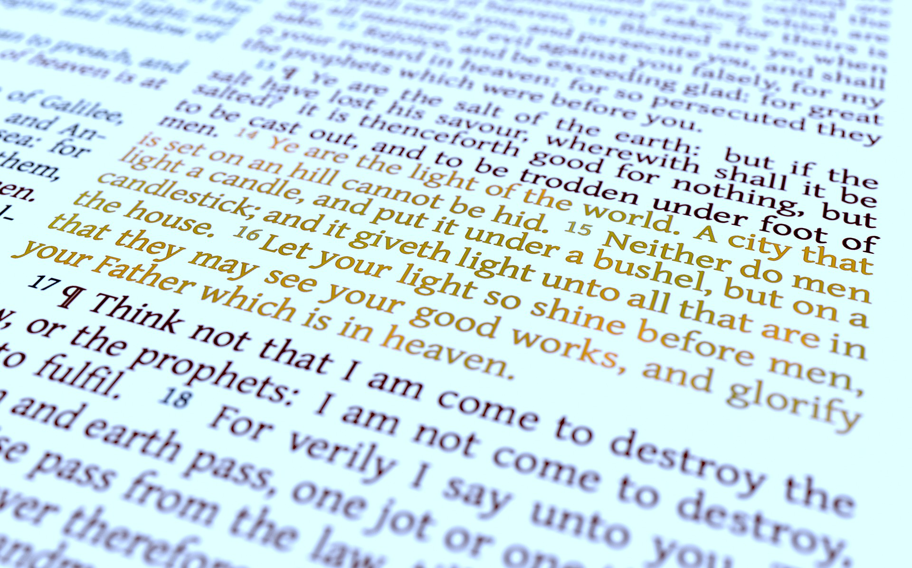
And The Bible Says What?
Let not your heart be troubled: ye believe in God, believe also in me. In my Father’s house are many mansions: if it were not so, I would have told you. I go to prepare a place for you. And if I go and prepare a place for you, I will come again, and receive you unto myself; that where I am, there ye may be also.
John 14:1-3

Slide 31
Just to be Clear: What God’s Word Does Teach
Heaven and earth will be destroyed and recreated in God’s time (2 Peter 3).
We all agree that heaven and earth will certainly not be reunited under Satan’s massive ecumenical scheme or in the manner in which Satan aspires – Via Ouranos, Gaia, and Chaos.
Although a grand re-creation is coming, the union of heaven and earth is not “what the story of the Bible is about.” That statement limits God to a cosmological worldview the end goal of which is merely to re-establish a race to rule His creation.
The “story of the Bible” is about God glorifying Himself through the expression of His attributes including His holiness and justice along with His love and redemption.
The earth is the stage on which the story of the Bible plays out and it is a forensic platform through which a loving and just God is working out His will. The separation and future re-creation of heaven and earth, as wonderful as that restoration may be, is secondary to this. (Revelation 21:1 & 2).

Slide 32
So, What is This Authority & Dominion Thing About?
In the BP worldview, the beginning and end of all that God has done and is doing relates to a Temple Mountain / Garden of Eden where heaven and earth were completely united;
Before heaven and earth were separated both spiritual beings (called elohim) and human beings cohabited Eden;
Humans were to have dominion (partnering with God) and were to build a beautiful, eternally perpetuated, world;
Divine authority was remanded to them and then disponed and corrupted by them.
Understanding the Bible Project Worldview.

Slide 33
Truth Mystified & Clarified
Heaven and earth never, ever overlapped by so much as one inch, though both were created by God. They are always described as separate entities. Something or someone may “come down” from heaven, but heaven has never come down to earth.
Humans never “partnered with God” in building a beautiful, flourishing world.
“So, let’s go back to the beginning where heaven and earth were completely overlapping. Yeah, this is what the Bible’s description of the Garden of Eden is all about. It’s a place where God and humanity dwelled together perfectly with no separation, and humans then partner with God is building a beautiful, flourishing world.”

Slide 34
Bible Project Word Alert! Partners
Holding our terminology to biblical usage and standards.
Are we “partners” with God?
When the BP suggests that we are partnering with God, they intend far more than that we are mere co-laborers with God. Remember:
God relegates, but never relinquishes His authority to men or angels. When we take Christ’s yoke upon us, we are not equal partners, we are co-laborers. We minister to God’s husbandry, not ours, and build on God’s temple (1 Cor. 3).
We will soon see this term play directly into the BP brand of “free agency” where God relinquishes His authority (and thus, His sovereign power) to men and other “elohim” and members of his “staff team” so-called as His “partners”.

Slide 35
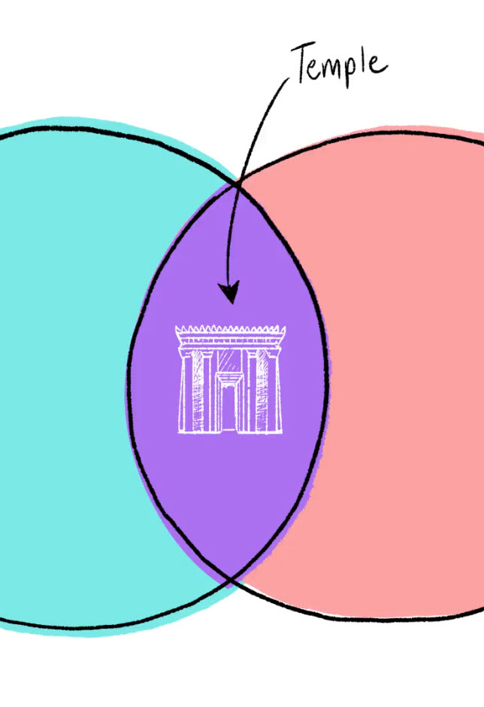
BP: Heaven and earth overlap in temples.
The BP says the temple that was originally part of earth is now in heaven only.
The BP says the separation of heaven and earth necessitated earthly temples:
“This is where we have to start talking about temples because, in the biblical world you experience God’s presence by going to a temple. That’s where heaven and earth overlap.” (1:53)
Understanding the Bible Project Worldview.

Slide 36
BP: Heaven and earth overlap in temples.
Notice that the subject has shifted to spaces. You will need to notice this geocentric perspective as the BP story moves along:
“At the center of the temple was a place called the Holy of Holies that was like the hotspot of God’s presence.
“The temple also creates a problem. God’s space is full of His presence and goodness and beauty. But human space is full of sin and injustice and ugliness.” (2:37)
Understanding the Bible Project Worldview.

Slide 37
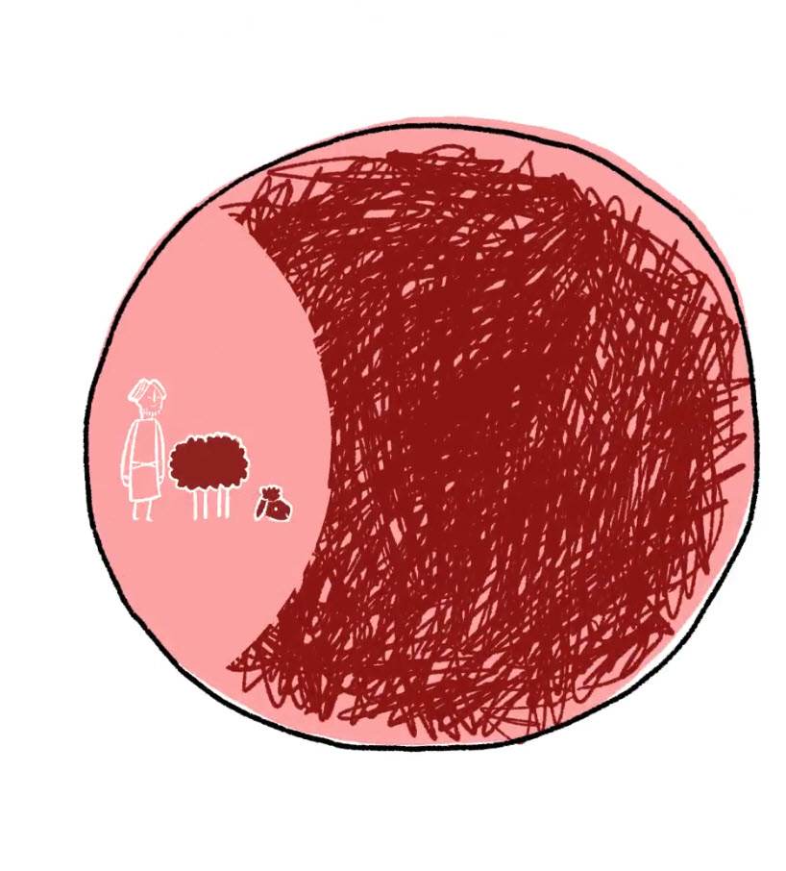
BP: Heaven and earth overlap in temples.
Notice that the subject has to spaces. You will need to notice this geocentric perspective as the BP story moves along:
“So, how do these spaces overlap? This was resolved through animal sacrifice.
“So, animal sacrifices, somehow, they absorb sin when the animal dies in your place, and it creates a clean space, so to speak where you are now free to enter into the temple and be in God’s presence.” (2:59) [Emphases Mine]

Slide 38
Seriously, Is There a “Problem” Here, or What?
“Temples are where heavenly and earthly spaces overlap”???
“This signifies a problem because God’s goodness and beauty is confined to His temple space”?
Animal sacrifices somehow “absorb sin in our place”?
“These sacrifices create a clean space so we are free to enter”?

Slide 39
Let Me Make One Thing Perfectly Clear..
God may sanctify His temple and the Ark as a means to confront men with His presence and supernaturally affirm His covenant promises.
God’s presence was never limited to a space on earth.
The blood of sacrificial animals has absolutely no cleansing power.
However, neither objects nor words have inherent power. To imbue the creation with spiritual power is witchcraft.

Slide 40
When we assign inherent power to anything inside God’s creation we are practicing Pagan magic and witchcraft.

Slide 41
And The Bible Says What?
“God that made the world and all things therein, seeing that he is Lord of heaven and earth, dwelleth not in temples made with hands; Neither is worshipped with men’s hands, as though he needed any thing, seeing he giveth to all life, and breath, and all things;”
Acts 17:24,25

Slide 42
And The Bible Says What?
“For it is not possible that the blood of bulls and of goats should take away sins. Wherefore when he cometh into the world, he saith, Sacrifice and offering thou wouldest not, but a body hast thou prepared me. In burnt offerings and sacrifices for sin thou hast had no pleasure.”
Hebrews 10:4-5

Slide 43
Truth Mystified & Clarified
Again, notice the spatial concept.
God’s goodness and beauty, once confined to the temple, is now transported by God’s mobile temple, Jesus Christ, who creates little pockets of heaven “out there in the world of sin and death”.
“Jesus, God’s tabernacle, goes about creating little pockets of heaven wherever He goes. He does it ‘out there’ in the world of sin and death.” (4:29)

Slide 44
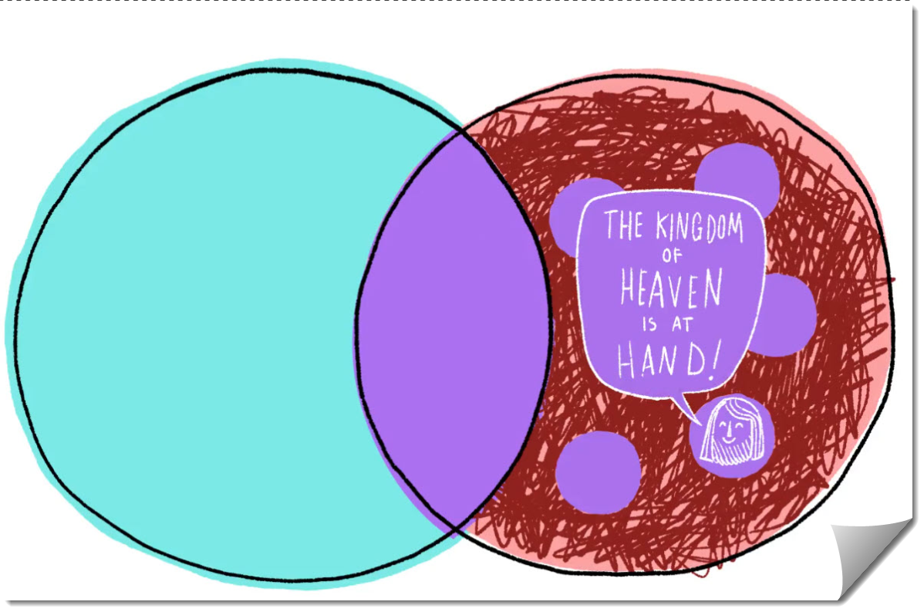
Nothing but the facts:
Jesus did tabernacle on earth, and, of course, He was God, and yes, He did travel about offering the Kingdom of God!
Jesus did not create little spatial pockets of goodness and beauty wherever He went.
Many repented as they heard Christ’s warnings, but the ground under their feet and the space around them was no different after their encounters.

Slide 45
Truth Mystified & Clarified
“The cross is now the place where Jesus absorbs sin to create a clean space that is not limited like animal sacrifices. (4:56)
Jesus’ sacrifice has the power to keep spreading and spreading and reuniting more and more of heaven and earth.
This is serious error.
Jesus did not absorb anything on the cross. He did not create a clean space in an unlimited way compared to the limited space animal sacrifices could cover. This is insanity.
Christ took our sins by placing us in Himself, thus satisfying the wrath of God through His death.

Slide 46
Paradise Restored
In the BP narrative:
This same Eden will supposedly be restored in the form of the New Jerusalem as ultimate divine authority is reasserted and redistributed among Yahweh’s “staff team” and “partners”.
The New Humanity, so labeled, will eventually partner once again with God, reigning over His creation.
Understanding the Bible Project Worldview.

Slide 47
The Truth and the Error
A
B
True: The New Jerusalem, the Millennial land, and the eternal state are described in the Bible in paradisiacal terms, (Ez. 51:3), but they are not Eden restored.
False: God’s story is about far more than Eden lost and Eden restored! It is about far more than dominion lost and dominion regained! Salvation is far more than regaining lost ground and ruling a new Edenic world.
D
False: The ultimate BP message that evil is overcome through sacrificial love is not biblical. The victory that overcomes the world is our faith in the vicarious work of Christ, not merely His self-sacrificial act of love.
C
False: History is not about God’s authority being relinquished to His “free agent” creatures. It is about is the glorification of our loving God through our justification & redemption.
A
B
C
D

Slide 48
Video: Heaven and Earth
Video
Review
This is no innocent use of metaphor in order to present a fresh new presentation of the gospel.
You have just witnessed a tiny dose of the BP’s great infusion of pagan thinking into our biblical worldview.

Slide 49
Welcome to Paganism 101!
Don’t fall into the metaphor trap. The BP is not merely imposing a well-woven metaphor to explain how God’s love will reconquer a fallen dominion.
In these videos and supplemental materials you will witness the old pagan (Ugaritic and Chaldean) worldview being imposed on the entire Bible story.
You will observe the subjugation of God’s plan and program to a creation-based world view. God’s program is not about space disponed and reconquered. It is not about inherent spiritual power being given to physical objects such as temples, arks, and blood from sacrifices.

Slide 50
Navigating TREACHEROUS WATERS
How to Cross the Line!
The Metaphor Shell Game
A. Take a word which has two meanings – such as hosts. It can refer to any large gathering of beings or objects. These are easily defined by the context in which the word is used.
B. Find another use of the word from a different context.
C. Reimpose the second use of the word on the first meaning and form your new doctrine!
Example: Because the hosts of heaven can sometimes refer to angels, the BP tells us that the sun, moon, and stars referred to in Genesis 1:16 are “spiritual beings” given to us for “signs.”

Slide 51
Navigating TREACHEROUS WATERS
How to Cross the Line!
The Pagan Witchcraft Game
A. Take an object through which God manifests His presence or His power. This can be Aaron’s rod, the Ark, or even the garment which Jesus wore.
B. Now, assign the power directly to the object itself.
C. You have just crossed the line into pagan witchcraft. There is no spiritual power in physical objects or confessional words.
Example: Because God used blood sacrifices to point us to Christ’s ultimate sacrifice does not suggest that animal blood can “absorb sin” and “create clean spaces”. That’s witchcraft!

Slide 52
Navigating TREACHEROUS WATERS
How to Cross the Line!
The Jewish Background Game
A. Good background studies along with good grammar studies help us gain a fuller, richer understanding of God’s message.
B. Because the Bible interprets itself, we must never rely background materials to form an interpretive lens.
C. To so require outside wisdom means, our Bible is incomplete and insufficient without those uninspired studies. We must now trust “higher knowledge.”
Example: Many of the BP’s constructs for understanding spiritual beings come directly from pagan sources and Jewish sources which had been corrupted by pagan influences.

Slide 53
SLIDE BANK
Your Main Title
Extra Text or Subtitle Here
SESSION 1
THE WAR AGAINST CHRIST
The Arena
Case Study: Bible Project - Heaven & Earth Melded
Ancient Arguments
Aquinas officiates at the forbidden marriage!
Click any of the text to change out for your own. Some reformatting and stretching may be necessary in order to fill the gaps.
Here’s a good place to put your own text, a good example of what it looks like on this sticky note.

Slide 54
The Goal of all Philosophers- To Arrive at a Unified System of Knowledge
Notes:
Never forget the goal of all philosophers.

Slide 55
Call it what you will.
This brick wall represents the basic struggle (and failure) of all philosophers in all time.
The Philosophic Dilemma
Philosophy cannot have a unified system of knowledge until it reunites the whole of existence* under one system.
*Call it what you will, heaven and earth, spirit and matter, or a host of other terms.
Mr. Spiritual
(Spiritual) Being known through IDEAS already innate in the mind.
Mr. Matter
We must rebuild our knowledge by finding a single constant in the universe. (Atomist Theory)
Notes:
Just remember – Dr. Plato believes reality through IDEAS which are innate. He has no time for material considerations. Democritus and friends are trying to rebuild Greek philosophy by ignoring the spiritual and trying to find a single, absolutely verifiable and UNCHANGING element in the material world. Philosophy was up against a brick wall.

Slide 56
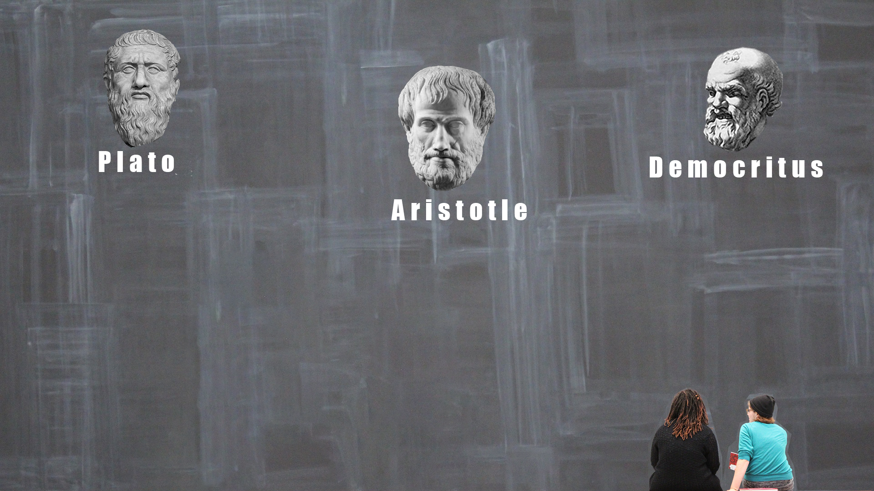
Mr. Spiritual
Mr. Material
Aristotle Tried
(384-322 B.C.)
The Problem:
His humanistic solution places subjective sensibility ahead of reason.
Spirit and Material are known through the human senses. Thus replacing both Plato’s “innate” knowledge and Democritus’ materialism.
Notes:
Aristotle will try to reconcile these opposing concepts by suggesting we really know what we know through our senses. In his world, man decides what is reality.

Slide 57
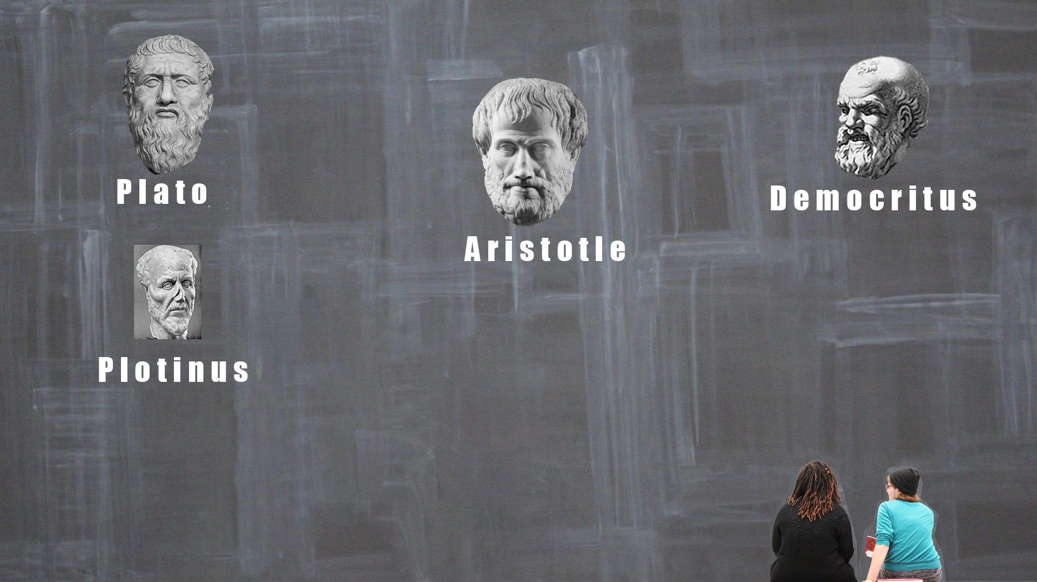
Enter Plotinus (204-270 A.D). Mr. Mystical
Centuries later Plotinus adds a whole PITCHER FULL of mysticism into dormant Platonism.
Mysticism stresses our universal connection to each other and the universe. Together we make up the god element. (Pagans have always believed this, Bible believers reject this.)
His Neo Platonism, then, was a heavy cream blend of Platonism and mysticism.
Watch out, girls!
Notes:
After centuries long struggles, Plotinus adds his grey matter to the mix. He revives Platonic thought, but mixes high doses of mysticism into his recipe. This Neo Platonism satisfied both the intellect and the need in all men to connect on a spiritual level.
The Bible calls this having a form of godliness. While some may consider this unfair, keep in mind that all false religions need this mystical connection. Neoplatonism would have died completely, were it not for Augustine who tried to synthesize it.

Slide 58
Notes:
But, let’s get back to our new breed of thinkers, the Philosopher/Theologians. Two of them, in particular, are movers and shakers.

Slide 59
Until this point…East was East and West was West…
Creation Based Philosophers
Creator Based
Church Theologians
…so to speak
Notes:
Now, global warming was beginning to happen before everyone’s eyes…
First we had two clearly defined groups…

Slide 60
But Philosophy & Theology Were Beginning to Converge
Creation Based Philosophers
Creator Based
Church Theologians
Enter the Philosopher /Theologians!
Notes:
Now, we are beginning to blur the lines, under the auspices of “synthesizing” philosophic thought with religious thought.

Slide 61
Now, That’s an Oxymoron!
A philosopher is creation based.
We might say he starts with earth. He sources his information any and all sources –
Science, Nature, Innate Knowledge, Intuition, Grandma’s wisdom, Etc.
A Bible believer is Creator based.
We might say he starts with God as revealed in the Bible.
He filters all other information from any and all sources – based on what the Bible says.
We have two conflicting first principles. One starts with the creation and tries to reason its way up. The other starts with the Creator and reasons its way down.
Notes:
However, philosophers and theologians are opposites, or at least they’re supposed to be!
To this very day we have apologists who teach us that we can reason our way to God. If that were the case, human reason, not divine revelation, would be supreme. Worse, it places the authority of God’s written Word on the same plane as natural revelation.

Slide 62
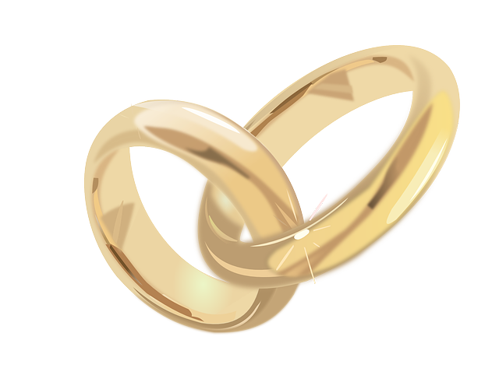
Two Philosopher/Theologians Thought They Could Perform this Marriage Ceremony
One
Creator/Creation Based
System Begins
To Emerge
Be ye not unequally yoked together with unbelievers: for what fellowship hath righteousness with unrighteousness? and what communion hath light with darkness? And what concord hath Christ with Belial? or what part hath he that believeth with an infidel? And what agreement hath the temple of God with idols? 2 Corinthians 6:14-16a
Notes:
In order to bring about this marriage we need a special breed of thinker. We need the philosopher / theologian.

Slide 63
Until now…
Remember, folks, synthesis is always a two way street.
So, Augustine (354-430 A.D.) had been a fellow traveler of a complex dualistic cult called Manichaeism prior to his “conversion…”
Many long venerated Catholic orders have followed Augustine down through the centuries including the Franciscans.
The Platonic Augustine tried to synthesize Neo-platonism with essential Catholic theology, opening the door for much more mysticism.
And, as a religious scholar, he was deeply influenced by Neoplatonism and our friend Plotinus.
Notes:
For centuries, Augustine was the last word in Catholic theology. He loved the mystical side of Neoplatonism and did a fine job of synthesizing this leaven with the doctrines of his church.

Slide 64
Until now…
After hundreds of years, a fresh thinker arises:
Thomas Aquinas (1225-1274) was probably the most prolific writer in church history.
It would be fair to say that Thomistic thought is the most dominant force in Catholic thinking today. And why would that matter?
He edged the church toward Aristotelian thought, but was also heavily influenced by Neoplatonism.
Aquinas would possibly have called himself an Augustinian, but in reality, he is going to “one up” them all.
Notes:
Aquinas, however will come along later, and put Augustine to shame. He didn’t stop with synthesizing the earlier philosophers. He was about to add the most powerful ingredient that had ever been blended into the mix…

Slide 65
An Important Thing to Remember
A philosopher is creation based.
The issue is not whether God reveals Himself in nature.
The issue is what God reveals and what He does not reveal through nature.
God’s revelation in nature is primarily to glorify Himself and to testify to His existence and power.
Fallen nature cannot reveal the attributes of God, the will of God, or the path back to God. (Natural theology is not an authentic discipline.)
A Bible believer
is Creator based.
For the wrath of God is revealed from heaven against all ungodliness and unrighteousness of men, who hold the truth in unrighteousness; Because that which may be known of God is manifest in them; for God hath shewed it unto them. For the invisible things of him from the creation of the world are clearly seen, being understood by the things that are made, even his eternal power and Godhead; so that they are without excuse.
^{Romans 1:18-21}
Notes:
However, philosophers and theologians are opposites, or at least they’re supposed to be!
To this very day we have apologists who teach us that we can reason our way to God. If that were the case, human reason, not divine revelation, would be supreme. Worse, it places the authority of God’s written Word on the same plane as natural revelation.

Slide 66
The Apostle Peter said:
For we have not followed cunningly devised fables, when we made known unto you the power and coming of our Lord Jesus Christ, but were eyewitnesses of his majesty. For he received from God the Father honour and glory, when there came such a voice to him from the excellent glory, This is my beloved Son, in whom I am well pleased. And this voice which came from heaven we heard, when we were with him in the holy mount. We have also a more sure word of prophecy; whereunto ye do well that ye take heed, as unto a light that shineth in a dark place, until the day dawn, and the day star arise in your hearts: Knowing this first, that no prophecy of the scripture is of any private interpretation. For the prophecy came not in old time by the will of man: but holy men of God spake as they were moved by the Holy Ghost.
^{2 Peter 1:16-21}
The written scriptures are even more authoritative than Peter’s own eye witness account of the transfiguration! The scriptures alone are our authority because they are the self revelation of our God.
Notes:
The scriptures are quite outspoken about this. Nothing trumps the written Word of God – not philosophers, popes, or even Baptist preachers!

Slide 67
Or, to put it in biblical terms...
A philosopher is creation based.
The wisdom of man is foolishness with God and ends in creation worship.
One cannot know God by wisdom.
A Bible believer is Creator based.
The foolishness of God is wiser than the wisdom of men! God will bring to nothing the wisdom of the wise.
For it is written, I will destroy the wisdom of the wise, and will bring to nothing the understanding of the prudent. Where is the wise? where is the scribe? where is the disputer of this world? hath not God made foolish the wisdom of this world? For after that in the wisdom of God the world by wisdom knew not God, it pleased God by the foolishness of preaching to save them that believe.
1 Cor. 1:19-21
Notes:
Man thinks nothing about mocking the wisdom of God. In reality, God is quite offended by this idea that man can know a single thing without Him!

Slide 68
Forbidden Romance: Why Theology & Philosophy Can Never Marry!
But the natural man receiveth not the things of the Spirit of God: for they are foolishness unto him: neither can he know them, because they are spiritually discerned.
^{1 Corinthians 2:14}
According to the Bible, a natural man is one who has not yet been born again by the Spirit of God. Read the entire chapter.
Notes:
Philosophers and theologians who do not have the Spirit of God dwelling in them will always be learning, but never finding the truth. God says so. God is truth, but He will never be “rational.”

Slide 69
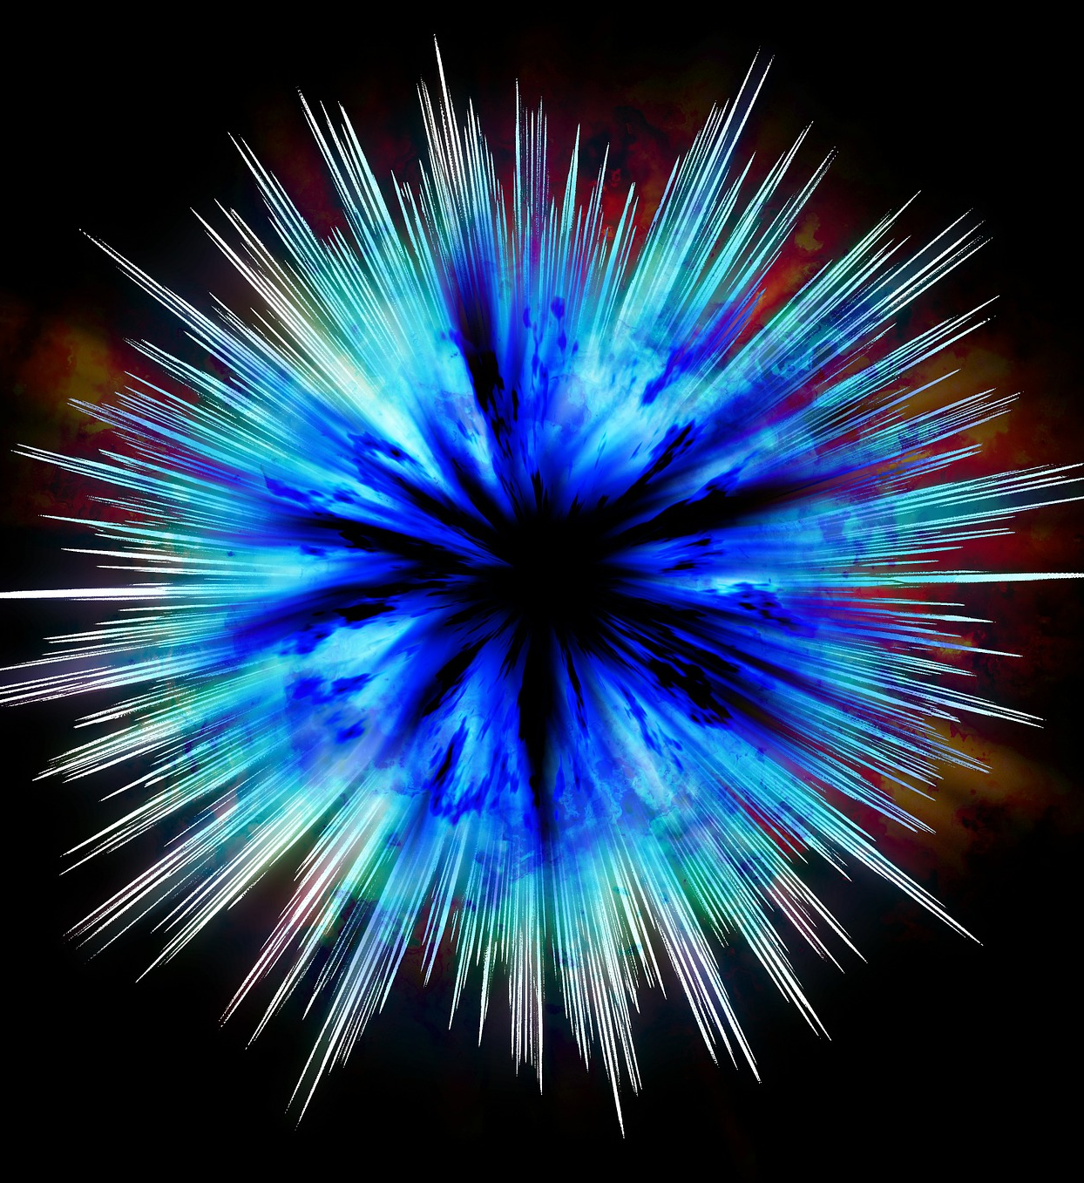
Aquinas is about to make a quantum leap.
Notes:
Things are about to change….drastically.

Slide 70
Keeping Things in Perspective
We do not mean to vilify Thomas Aquinas
Aquinas had many good things to say…
Thomas had many benign things to say that are now considered antiquated.
Thomas is not responsible for later, Neo Thomisians will try to clarify or extend his teaching – perhaps, beyond his intent.
Aquinas did, however, make one malignant error which will reap havoc in the centuries to follow…
Notes:
Never think for a minute, that we are challenging Aquinas’ character! He did, however, open Pandora’s box!

Slide 71
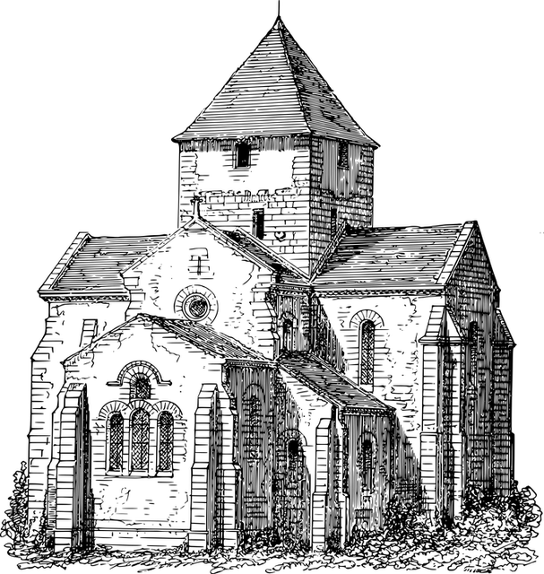
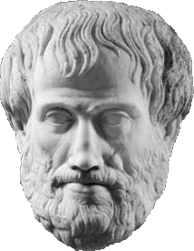
Not “into” Aquinas? Just hang on to this…
“Thomas, moves the church away from Plato and towards Aristotle, and in so many words, he says:
Since God said to Moses, I AM, therefore he is the changeless self existent One: "ipsum esse per se subsistens".
If God is absolutely changeless, then what he made could also have a changeless being.
(His writings led his disciples to use the Latin noun of the verb to be (esse) essentia for substances.)
Thus, the essence of became the Western metaphysic. Substance is changeless!”
For now:
*Special thanks to Victor McAllister for this short summary.
Notes:
Thomas shifts this debate between spirit and matter back towards the middle, so to speak, but then, he drops the other shoe. By starting with the idea that God is unchanging he makes a logical leap and suggests that the matter which God created could also have a changeless being.

Slide 72
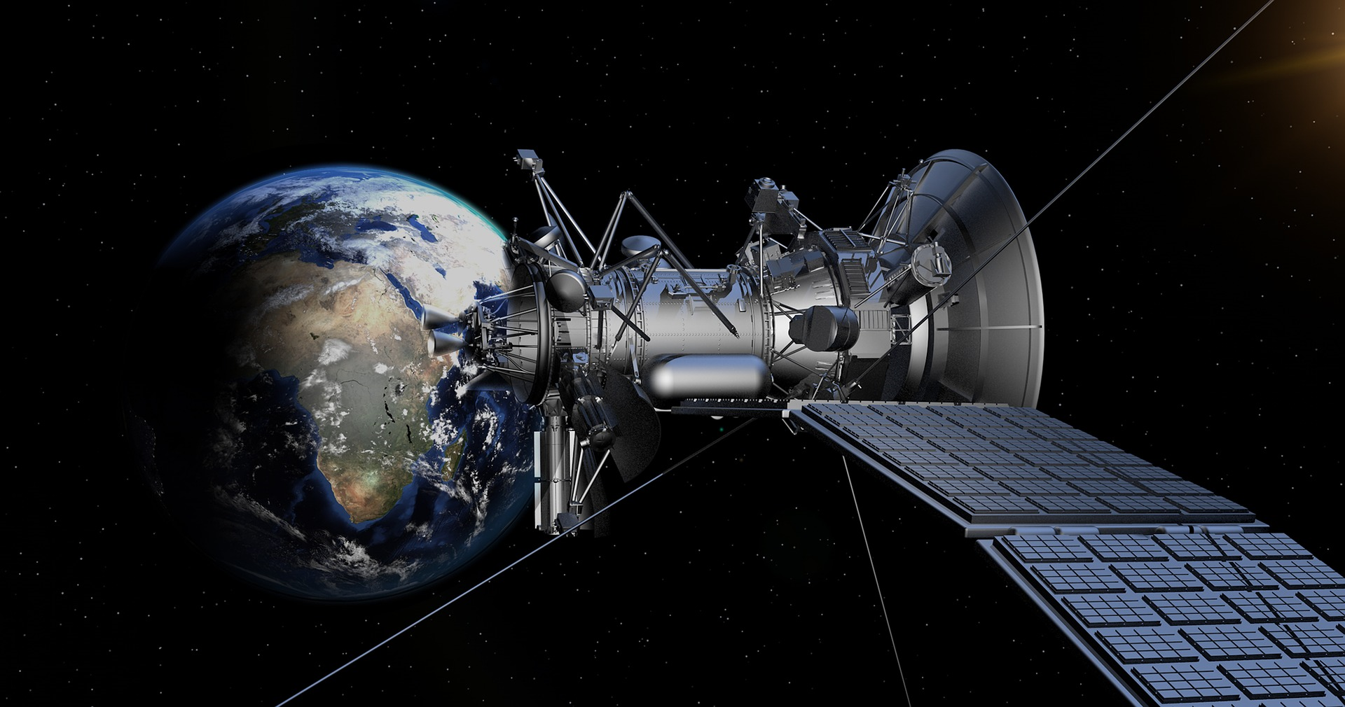
Remember: Philosophy Could Never Find a Starting Point (F.P.)
You and I know that without God philosophy cannot arrive at a unified system of knowledge. It cannot reconcile spirit and matter. It cannot find a “starting point.”
Parmenides (515 to 540 B.C.) argued that there can be no science until we find an unchanging constant.
Zeno’s (490-530 B.C.) Paradox will show us that synthesis through the senses is unworkable.
Democritus (460-370 B.C.) had argued that must find a single (material) constant from which to rebuild our entire system of knowledge. In our words, we must find something unchangeable before we can make sense out of change.
Aquinas has just given creation based philosophers exactly what they wanted. (Or so he thought.) Maybe now, philosophers will give God a second thought!
Aristotle (384-320 B.C.) sought to find it in his synthetic view of changelessness (hypokeimenon).
Notes:
Philosophy has been struggling to find a constant in the creation for centuries, if not millennia…

Slide 73
What Was the Quantum Leap?
First, it was a Theological Leap
From Biblical Theism
God exists apart from His creation
To Panentheism
God and His creation are substantive.
Notes:
Aquinas takes the Quantum Leapl. First, it is a leap from biblical theism to panentheism….

Slide 74
Remember What God’s Word Says
3. While God fills His creation, His substance is separate from it.
4. Believers experience true oneness by virtue of being placed in Christ Christ, but our substance never becomes God’s substance.
5. Therefore, there is NO essential oneness between natural men and their creation or their Creator.
The natural man CANNOT know God.
1 Cor. 2:14
1. GOD IS.
2. God created the universe and carries it forward through His Son. Col. 1:1-19, Heb. 1:3
God exists eternally – outside of any created thing.
Notes:
In biblical theism, God is entirely separate from His creation, though, of course, He fills it.

Slide 75
Remember What Essential Panentheism Is
God moves
From existing eternally – outside of the creation…
2. Yet “the whole is in god”, because his energy transcends it.
1. God is “the whole” of the material and non material universe.
Yet…
“The whole is in god.”
“God is “the whole”
Thus: There is an essential oneness between “god” and the whole. God is all. We are all “god”. Because I can connect with this energy of “god” and YOU can connect with it, we can EXPERIENCE our ONENESS.
Again, this false, transcending glory, is a counterfeit explanation for the Person and work of Christ in creating, filling, and carrying the universe forward. (Hebrews 1:3)
Notes:
In panentheism, God is the whole of the creation, yet, the whole is in God. This is because the god energy transcends and slightly exceeds the universe.
The goal of panentheism is to provide a mystical fabric whereby we can all connect and realize our oneness with each other and the universe.

Slide 76
We now have a creation which is God and yet distinct from God!
God moves
From existing eternally – outside of the creation…
2. Yet “the whole is in god”, because his energy transcends it.
1. God is “the whole” of the material and non material universe.
Yet…
“The whole is in god.”
“God is “the whole”
Wait until you see how this is going to mesh with a most astonishing heresy in our next session!
Notes:
In panentheism, God is the whole of the creation, yet, the whole is in God. This is because the god energy transcends and slightly exceeds the universe.
The goal of panentheism is to provide a mystical fabric whereby we can all connect and realize our oneness with each other and the universe.

Slide 77
Now, remember what Aquinas said!
Since God said to Moses, I AM, therefore he is the changeless self existent One:
This certainly is correct. God, and God alone is the self existent One and He is changeless.
If God is absolutely changeless, then what He made could also have a changeless Being.
In "ipsum esse per se subsistens“ Aquinas said there is no difference between Being and essence.
ERROR: God cannot create anything that is changeless in its essence. Immutability is an incommunicable attribute of God that belongs to Him alone and it cannot be discrete from His other attributes.
For example, if matter is changeless, it must also be self existent and could not have been created or destroyed.
Thus, the essence of was endowed with a divinity of sorts and became the Western metaphysic. Substance is changeless.
This is essential PANENTHEISM. To blur the line between the Creator and His Creation makes God a part of the creation and the creation a part of God. Period.
Notes:
Thomas made a colossal error which played right into the hands of panentheists. He tried to assign the attribute of an unchanging God to a changing creation. By doing that he joined the Creator with His creation.

Slide 78
What Was the Quantum Leap?
Secondly, it was a Cosmological Leap
To Changelessness
Within the Creation
A Changeless constant.
From A Changing Creation
God
For another day:
Of course, if we’re talking about changelessness versus change we’re also talking about time.
Please understand that much can and must be said about the views of Augustine and Aquinas on time. Their conclusions have had far reaching consequences in western science.
However, important as this study is, we must set it aside in order to stay on task. Aren’t you glad???
Notes:
Aquinas’ leap also formed the basis for a new cosmology. Both Aquinas and Augustine re-define how we define and measure time. Time as we know it was not created, it was invented. This is just a heads-up as it goes “light years” beyond this study!

Slide 79
Let’s Reduce Thomas’ Hot Sauce
Notice God’s Cosmology:
“But the day of the Lord will come as a thief in the night; in the which the heavens shall pass away with a great noise, and the elements shall melt with fervent heat, the earth also and the works that are therein shall be burned up.
Seeing then that all these things shall be dissolved, what manner of persons ought ye to be in all holy conversation and godliness,
Looking for and hasting unto the coming of the day of God, wherein the heavens being on fire shall be dissolved, and the elements shall melt with fervent heat?”
^{1 Peter 3:10-12}
What Aquinas Claimed:
While Thomas did not claim matter was unchangeable (it had accidental qualities) he did claim that it had a changeless essence. That was his first cosmological principle.
Notes:
And, by the way, here’s one tiny cosmological reason why Thomas was wrong. If something is changeless, it cannot pass away. Yet, this creation will go out in one big bang.

Slide 80
What Was the Quantum Leap?
Thirdly, it was an Epistemological Leap
To Placing the Scriptures and Nature on The Same Level
From The Bible as our First and Final Authority
Epistemology simply refers to our doctrine of truth.
Notes:
What is very important to understand, however, is that Aquinas also did harm to the doctrine of the literal inspiration of scriptures.

Slide 81
This simple declaration is the staple of all panenthic, occultic, and new spirituality systems.
Panentheism teaches: “The Oneness of all that is.”
Wikipedia:
Briefly put, in pantheism, "God is the whole"; in panentheism, "The whole is in God." This means that the Universe in the first formulation is practically the Whole itself, but in the second the universe and God are not ontologically equivalent. In panentheism, God is not exactly viewed as the creator or demiurge, but the eternal animating force behind the universe, with the universe as nothing more than the manifest part of God. The cosmos exists within God, who in turn "pervades" or is "in" the cosmos. While pantheism asserts that God and the universe are coextensive, panentheism claims that God is greater than the universe and that the universe is contained within God.^{[2 -Wikipedia]} [Highlighting and italics, mine.]
Notes:
For further look at Panetheism check out Wikipedia. Better yet, get Ray Yungen’s book A Time of Departing.

Slide 82
Remember, every false system must find a way to minimize the authority of God’s Word.
God
God and His creation were placed on an equal plane.
God
Creation
Creation
Notes:
By placing God’s essence within the creation He placed God and the creation on an equal plane. This gives them the same epistemological authority. The scriptures may now be interpreted “though science” instead of vice versa.

Slide 83
Over time other cataclysmal errors will emerge from this convergence.
We’ll reheat this later!
God
Creation
The creation is also God’s essence and on an equal plane with the Word of God. Nature (Natural theology) is given by de facto equal authority with the written Word of God.
In time, the claim will be made that man himself was not simply made in the image of God – he was made with the substance of God. Oh, and why stop with substance? We all have the divine in us.
Thomas has just provided the theological justification for the practical claims the desert fathers were beginning to make. This would eventually result in the contemplative prayer movement we see all around us today.
Ecumenists will now justify treating ALL religions as spiritual fountainheads and all men as spiritual brethren.
We are all mystically connected with the creation and thus with each other. The trail to reuniting heaven and earth has been extended and paved!
Notes:
This Thomistic starting point will eventually reshape western thought. If Aquinas’ view is true, Paganism and Christianity are just two sides of the same coin! We are now, all mystically connected!

Slide 84
Evangelical Breach #2: God’s Nature
God – Start with your First Principle!
GOD STANDS ALONE
GOD IS SEPARATE
GOD IS
Evangelical Emergents:
EITHER MATTER IS ETERNAL OR GOD IS ETERNAL
Evangelical Emergents:
SCIENCE IS MYSTICAL: CREATION HAS NO MYSTICAL LIFE FORCE WHICH DRIVES IT FORWARD.
SCIENCE IS RELIGIOUS: HAVE YOU EVER SEEN, TASTED, SMELLED, OR TOUCHED EVOLUTION?
Evangelical Emergents:
H & E BEGAN WITH GOD & WILL CONSUMMATE WITH GOD.
H & E WERE NEVER ONE & WILL NEVER BECOME ONE.
H & E ARE NOT CATEGORIES TO HELP US THINK ABOUT CREATION.

Slide 85
Evangelical Breach #1: God’s Authority
Click any of the text to change out for your own. Some reformatting (text sizing) and such may be necessary in order to make it look similar, depending on how much text you try to put in here.
Click on these icons and change the colors of them by right clicking on top of the section of the graphic and choosing format shape. From there you can change the color.
The Battle For Heaven & Earth
The War Against Christ
The first theater is in the area of biblical cosmology in a struggle which goes far beyond the traditional creationist / evolutionist conflict. We will learn how Satan has infused his first principle into science, how science has mounted a twofold war against Christ, and then, how evangelicals are blurring the biblical truths about heaven and earth – importing a whole new “Christian” world view!
Learn to discern!
This is a separate curved text box, apart from the top text box.

Slide 86
Evangelical Breach #2: God’s Nature
Click any of the text to change out for your own. Some reformatting (text sizing) and such may be necessary in order to make it look similar, depending on how much text you try to put in here.
Click on these icons and change the colors of them by right clicking on top of the section of the graphic and choosing format shape. From there you can change the color.
A Re-envisioned Godhead
The War Against God
The second theater involves the very natures of God, angels and demons, and men. Modern evangelicalism is shifting, and you should be noticing those who are subtly altering the way we look at God, the members of the trinity, the nature of His attributes, and, especially His sovereignty.
We have effectively embedded ancient pagan views of angels, demigods, and the divine council right into evangelical Christianity! We are witnessing, with our very eyes, Satan’s plan to bring the lie so close to the truth as to be almost indistinguishable.
Learn to discern!
This is a separate curved text box, apart from the top text box.

Slide 87
Evangelical Breach #3: God’s People
Click any of the text to change out for your own. Some reformatting (text sizing) and such may be necessary in order to make it look similar, depending on how much text you try to put in here.
Click on these icons and change the colors of them by right clicking on top of the section of the graphic and choosing format shape. From there you can change the color.
An Emergent False Church
The War Against the Spirit
The third theater in the battle for heaven and earth is visible in Satan’s attack on the work of the Holy Spirit through the spread of a new (old) spirituality and a biblically ignorant, convergent church. Our trans-religious spirituality glorifies Christ with the lips while not so secretly participating in idolatry behind the altar (Ezek. 8).
Judging by Christian bookstore sales, this warm and attractive spirituality is leading our women astray in droves and our men are not far behind. The battle is all around us and may even be in the pews among us. We echo Elijah, “How long halt ye between two opinions? If the Lord be God, follow Him!” (1 Kings 18:21).
Learn to discern!
This is a separate curved text box, apart from the top text box.

Slide 88
Evangelical Breach #4: God’s Gospel
Click any of the text to change out for your own. Some reformatting (text sizing) and such may be necessary in order to make it look similar, depending on how much text you try to put in here.
Click on these icons and change the colors of them by right clicking on top of the section of the graphic and choosing format shape. From there you can change the color.
A Hybrid Message is a Sterile Message
The War Against the True Gospel
The final theater involves Satan’s effort embed his false gospel into our preaching and teaching by melding kingdom truth with the gospel of grace. Add to the mix a new infusion of a gospel which suggests that we can overcome evil and reclaim world dominion through love and sacrifice. These beautiful gospels are so deceptively close to the true gospel that large numbers of evangelicals are now adr
ift in a sea of gospel chaos.
The statues have been torn down, the old defenders and their books have been locked in the tower, and the deceptively convincing tares have emerged from the soil.
Learn to discern!
This is a separate curved text box, apart from the top text box.

Slide 89
Repair the Breach
Click any of the text to change out for your own. Some reformatting (text sizing) and such may be necessary in order to make it look similar, depending on how much text you try to put in here.
Guard Your Church!
Deceit workers have transformed themselves into messengers of Christ!
2 Corinthians 11:13
Click on these icons and change the colors of them by right clicking on top of the section of the graphic and choosing format shape. From there you can change the color.
Guard Your Family!
Teach your children to recognize and refute error!
Ephesians 6:6
Guard Yourself!
Beware lest you fall from your own steadfastness!
2 Peter 3:17
This is a separate curved text box, apart from the top text box.
FORTIFY!

Slide 90
HEAVEN AND EARTH
The Battle is Here!
ARE YOU FORTIFIED?
Identify the Breaches
& Fortify the Body
A 2020 Biblical Intensive
StandingTrue.com

Slide 91
Evangelical Breach #1: God’s Authority
Click any of the text to change out for your own. Some reformatting (text sizing) and such may be necessary in order to make it look similar, depending on how much text you try to put in here.
Click on these icons and change the colors of them by right clicking on top of the section of the graphic and choosing format shape. From there you can change the color.
The Battle For Heaven & Earth
The War Against Christ
The first theater is in the area of biblical cosmology in a struggle which goes far beyond the traditional creationist / evolutionist conflict. We will learn how Satan has infused his first principle into science, how science has mounted a twofold war against Christ, and then, how evangelicals are blurring the biblical truths about heaven and earth – importing a whole new “Christian” world view!
Learn to discern!
This is a separate curved text box, apart from the top text box.

Slide 92
The Truth
The Breach
What God wants you to believe:
Click any of the text to change out for your own. Some reformatting (text sizing) and such may be necessary in order to make it look similar, depending on how much text you try to put in here.
Click on these icons and change the colors of them by right clicking on top of the section of the graphic and choosing format shape. From there you can change the color.
God created and controls the universe both by (fiat) direct command and by process. What we call the laws of nature God calls ordinances and decrees. There are no inherent constants or inviolable laws within matter.
The Lord Jesus Christ carries the universe forward in an ongoing instantaneous and interactive ministry on our behalf.
God has allowed both heaven and earth to be corrupted by sin and its results. He will redeem both heaven and earth by His blood and create them anew. Nothing in the Bible says they will become one.
The UNIVERSE self created and is controlled by (a yet undiscovered) constant.
The UNIVERSE (both organic and inorganic) is carried forward by a mystical force. We call this forward driving force EVOLUTION.
Heaven and earth are one.
This is a separate curved text box, apart from the top text box.

Slide 93
SLIDE BANK
Your Main Title
SESSION 2
THE WAR AGAINST GOD
The Arena
Elohim in God’s Image
Divine Council
Ancient Arguments
Imported by N.T. Wright and others
Don’t be duped by emergent ancient wisdom
Extra Text or Subtitle Here
Click any of the text to change out for your own. Some reformatting and stretching may be necessary in order to fill the gaps.
Here’s a good place to put your own text, a good example of what it looks like on this sticky note.

Slide 94
SLIDE BANK
Your Main Title
Extra Text or Subtitle Here
Click any of the text to change out for your own. Some reformatting and stretching may be necessary in order to fill the gaps.
SESSION 3
THE WAR AGAINST THE SPIRIT
The Arena
Enneagram
Ancient Arguments
Desert Fathers / Mothers – Spirituality
Here’s a good place to put your own text, a good example of what it looks like on this sticky note.

Slide 95
SLIDE BANK
Your Main Title
Extra Text or Subtitle Here
Click any of the text to change out for your own. Some reformatting and stretching may be necessary in order to fill the gaps.
SESSION 4
THE WAR AGAINST THE GOSPEL
The Arena
Gospel Toolkit Slide Set
Ancient Arguments
Augustine
Here’s a good place to put your own text, a good example of what it looks like on this sticky note.

